Slide 1


Slide 2
ABOUT ME
I am Sharika T R
Assistant Professor, CSE
Sree Narayana Gurukulam College of Engineering
Ernakulam
sharika100@gmail.com
www.sharikatr.in

Slide 3
End Semester Examination Pattern
PART A
  10 questions with 2 questions from each module,
  having 3 marks for each question
  should answer all questions
Part B
  contains 2 questions from each module of which a student should answer any one.
  Each question can have maximum 2 sub-divisions and carries 14 marks.

Slide 4
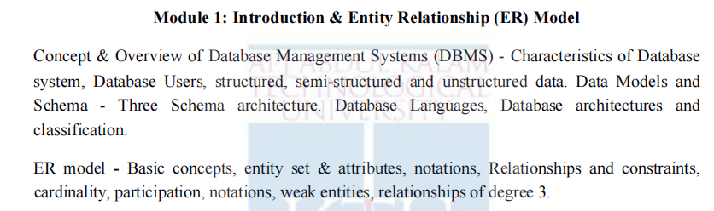
Module 1

Slide 5
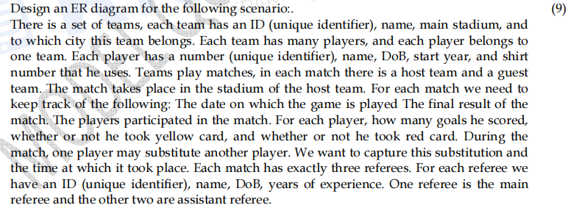
QUESTION TYPE 1

Slide 6
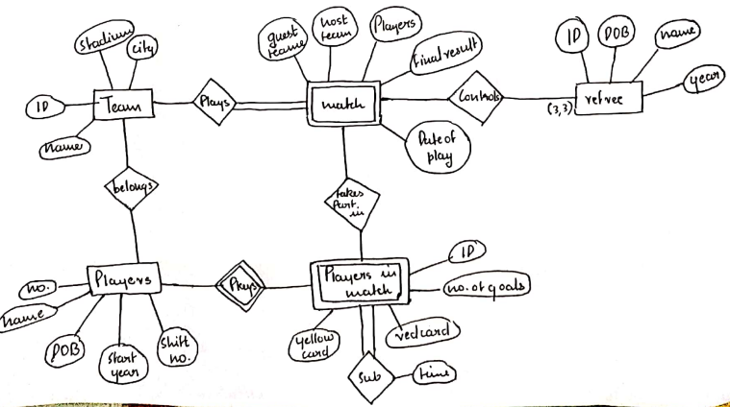

Slide 7
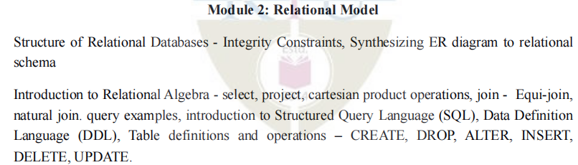
Module 2

Slide 8
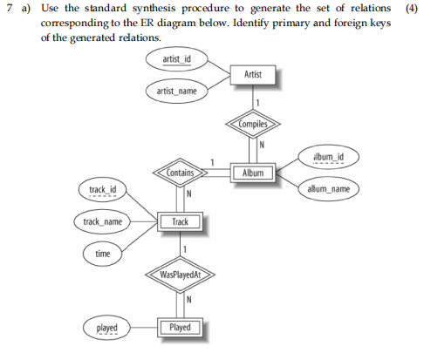
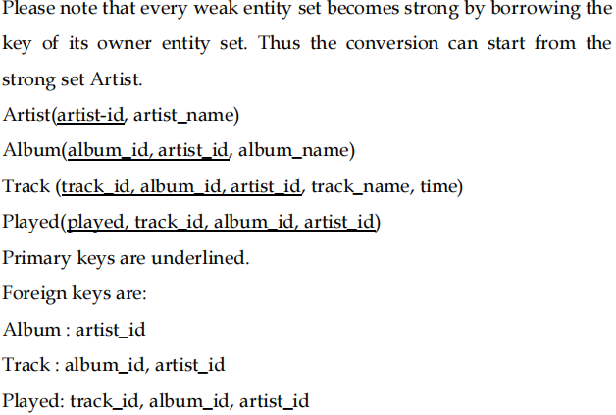
QUESTION TYPE 1

Slide 9

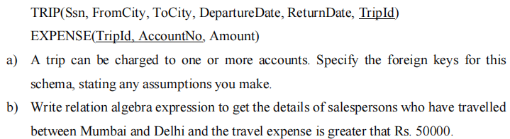
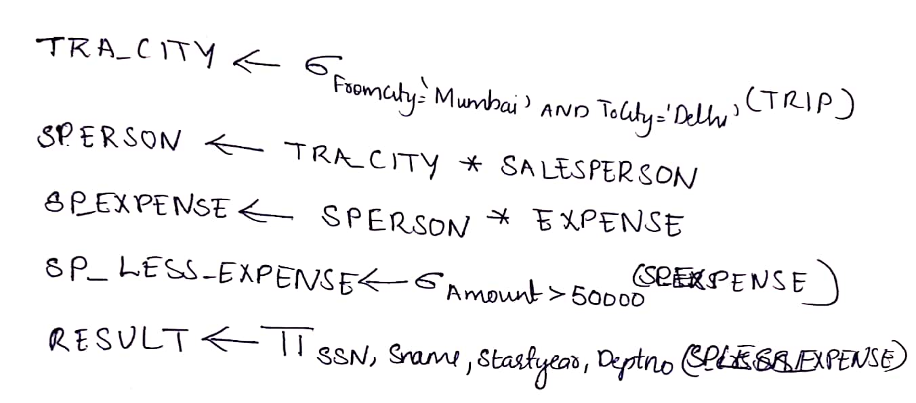
QUESTION TYPE 2

Slide 10
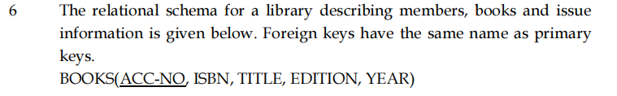
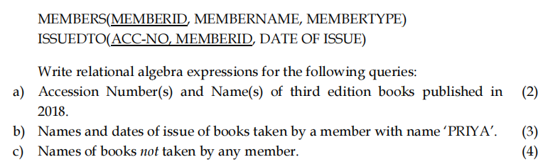
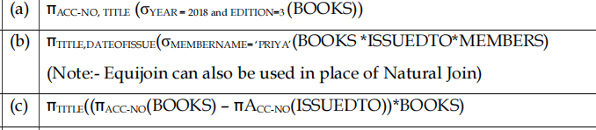
QUESTION TYPE 3

Slide 11
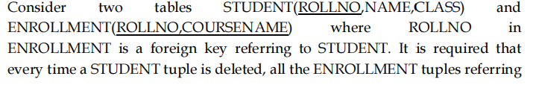
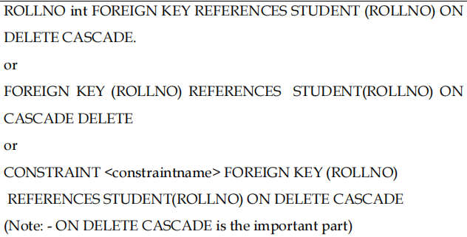
QUESTION TYPE 4
ANSWER.

Slide 12
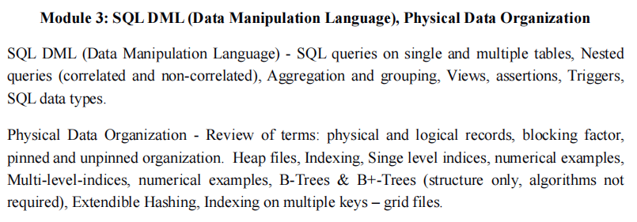
MODULE 3

Slide 13
QUESTION TYPE 1
1. In the following tables ADVISOR and TAUGHTBYare foreign keyd referring to the table PROFESSOR. ROLLNO and COURSEID in ENROLLMENT refer to tables with primary keys of the same name.
STUDENT(ROLLNO, NAME, AGE, GENDER, ADDRESS, ADVISOR)
COURSE(COURSEID, CNAME, TAUGHTBY, CREDITS)
PROFESSOR(PROFID,PNAME, PHONE)
ENROLLMENT(ROLLNO, COURSEID, GRADE)
Write SQL expressions for the following queries:
(i)Names of courses taught by ‘Prof. Raju’.
(ii)Names of students who have not enrolled for any course taught by ‘Prof. Ganapathy’.
(iii)For each course, name of the course and number of students enrolled for the course.

Slide 14
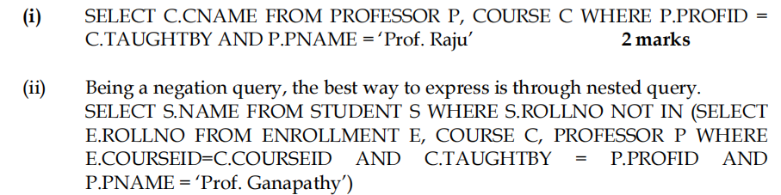
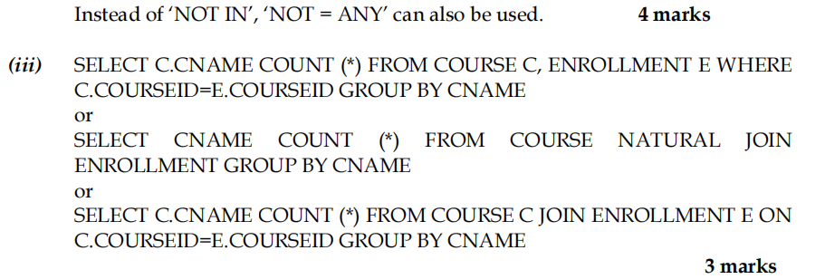

Slide 15
QUESTION TYPE 2
2. Suppose that we have an ordered file with 400,000 records stored on a disk with block size 4,096 bytes. File records are of fixed size and are unspanned,with record length 200 bytes. How many blocks are needed for the file? Approximately, how many block accesses are required for a binary search in this file? On an average, how many block accesses are required for a linear search, if the file is nonordered?

Slide 16
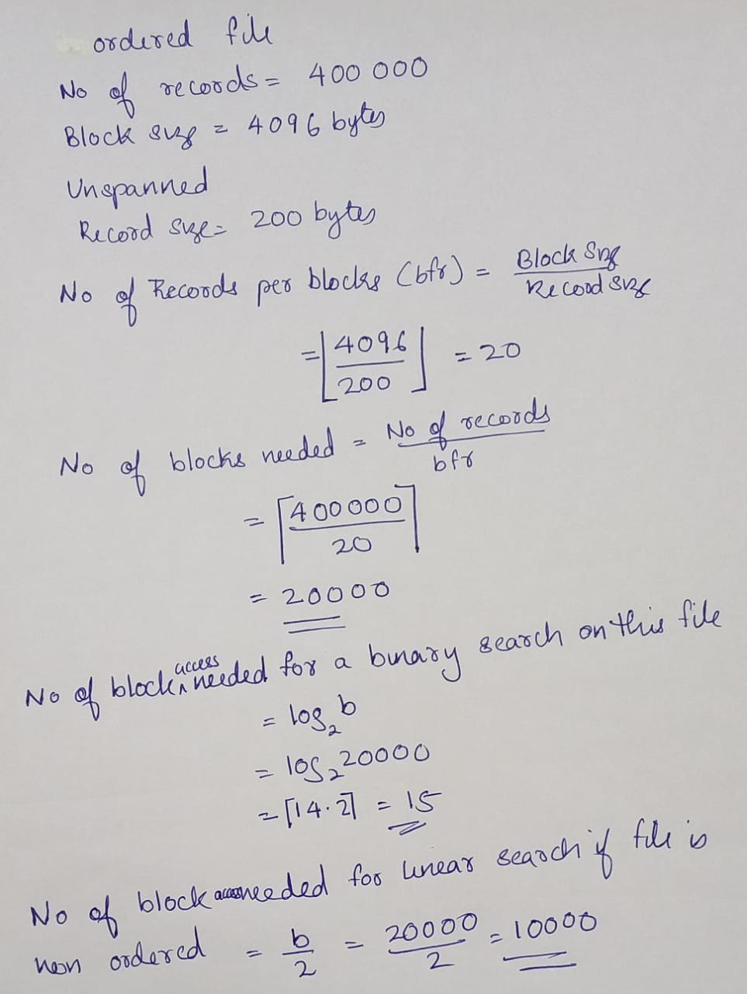

Slide 17
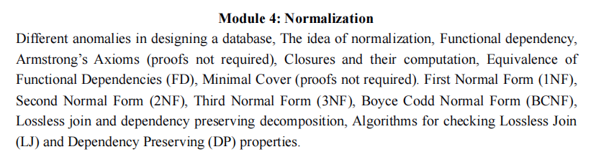
MODULE 4

Slide 18
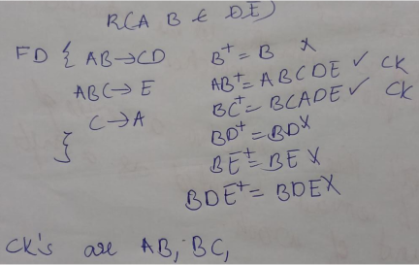
Question Type 1
Given R(A,B,C,D,E) with the set of FDs, F = {AB→CD, ABC →E, C →A}.
i)Find any two candidate keys of R (3)
ii)What is the normal form of R? Justify your answer. (6)
ii) AB→CD //SK(AB) determines prime(C)or non prime(D) allowed in 3NF
ABC →E // SK(AB) determines non prime(E) allowed in 3NF
C →A //Prime(C) determine Prime(C) allowed in 3NF
So this is in 3NF

Slide 19
Question Type 2
Given a relation R(A,B,C). Find the minimal cover of the set of functional dependencies given;
F= {A→BC, B→C, A→B, AB→C}

Slide 20
Question Type 3
Consider the relation R = {A, B, C, D, E, F, G, H} and the set of functional dependencies F = {A→DE, B→F, AB→C, C→GH, G→H}. What is the key for R? Decompose R into 2NF and then 3NF relations.

Slide 21
Question Type 4
Suppose that we decompose the schema R = (A, B, C, D, E) into
R1(A, B, C)
R2(A, D, E)
Test whether the given decomposition is a lossless-join decomposition, if the following set F of functional dependencies holds in R:
F= {A→BC, D→E, B →D, E →A}

Slide 22
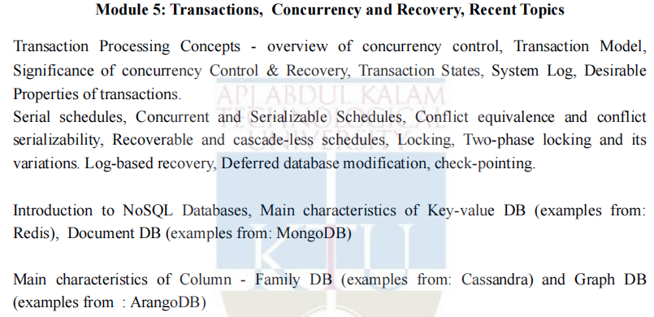
MODULE 5

Slide 23
Question Type 1
Determine if the following schedule is conflict serializable. Is the schedule recoverable? Is the schedule cascade-less? Justify your answers.
r1(X), r2(Z), r1(Z), r3(X), r3(Y ), w1(X), c1, w3(Y), c3, r2(Y), w2(Z), w2(Y), c2
(Note: ri(X)/wi(X) means transaction Ti issues read/write on item X; ci means transaction Ti commits.)

Slide 24
Question Type 2
Illustrate two-phase locking with a schedule containing three transactions. Argue that 2PL ensures serializability. Also argue that 2Pl can lead to deadlock.

Slide 25
ALL THE BEST FOR YOUR EXAMINATION

